Slide 1
Telerik Testing Framework
Software Quality Assurance
Telerik Software Academy
http://academy.telerik.com

Slide 2

The Lecturer
Georgi Darakchiev
Principal QA Engineer
XAML Team3

Slide 3

Table of Contents
Telerik Testing Framework Intro
Telerik Testing Framework Features
TTF vs. Test Studio
TTF vs. Selenium WebDriver
Telerik Testing Framework Demos
Testing web sites
Testing WPF applications

Slide 4
Telerik Testing Framework
Free .NET API for test automation
Supports Web (HTML, JavaScript, Ajax, …)
Supports Silverlight Applications
Supports WPF Applications
Includes some nice extras like
Browser abstraction
Wrappers for Telerik Rad Controls
Build-in handlers for Popups and Browser Dialogs
Element identification using LINQ

Slide 5
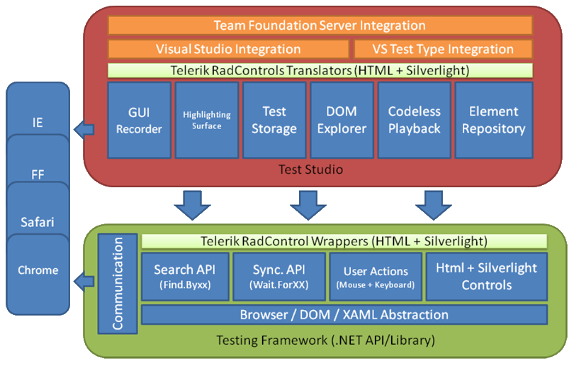
Telerik Testing Framework vs. Test Studio

Slide 6
Telerik Testing Framework vs. Selenium
 | Telerik Testing Framework | Selenium WebDriver
Multi-browser support | Yes | Yes
Headless Browsers support | No | Yes
Silverlight | Yes | No
WPF | Yes | No
Language | C#, VB .NET | Java, C#, Python, Ruby, JavaScript

Slide 7
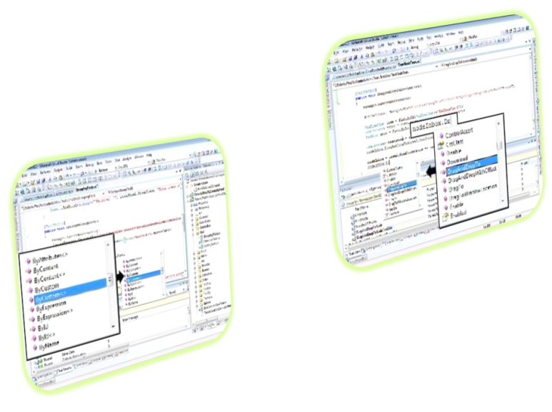
Testing Web (Demo)
Locate elements
Find.ById
Find.ByAttributes
Find.AllByTagName
Find.All*
HtmlFindExpressions
Linq

Slide 8
Testing Web (Demo)
Perform actions
Methods of HtmlControls
Keyboard and Mouse classes
Advanced
LaunchNewBrowser (BrowserType.Chrome)
Manager.Current.Settings
ActiveBrowser.WaitForElement
ActiveBrowser.ContainsText
ActiveBrowser.RefreshDomTree()

Slide 9
Testing WPF (Demo)
Getting started
Inspect WPF visual tree
Start/Connect WPF application
Locate elements
Find.ByName
Find.ByType
ByAutomationId
XamlFindExpression
Linq

Slide 10
Testing WPF (Demo)
Perform actions
Methods of FrameworkElements
Methods on WPF controls
Keyboard and Mouse classes
Advanced
WpfWindow.RefreshVisualTrees
ActiveApplication.WaitForWindow

Slide 11
Telerik Testing Framework
?
?
?
?
?
Questions?
?
?
?
?
?
?

Slide 12
Exercise
Write a test that:
Navigates to http://www.w3schools.com/
Verify the page is correctly loaded
From left menu click on “Learn HTML” link
Verify that you are on the correct page

Slide 13
Exercise
Write a test that:
Navigates to http://demos.telerik.com/kendo-ui/datetimepicker/index
Locates the DateTimePicker and asserts its text
Change the text and check if the text is changed
Opens the Calendar and select a date
Check that the text of the DateTimePicker is correctly changed with the new date

Slide 14




Free Trainings @ Telerik Academy
C# Programming @ Telerik Academy
csharpfundamentals.telerik.com
Telerik Software Academy
academy.telerik.com
Telerik Academy @ Facebook
facebook.com/TelerikAcademy
Telerik Software Academy Forums
forums.academy.telerik.com

